Slide 1
NextHikes IT Solutions Mobile Phone Price Prediction Using Machine Learning and Feature Importance Analysis
- Presented by Parul Srivastava

Slide 2
Abstract
This project aims to predict the price of mobile phones using machine learning techniques based on their specifications.
The dataset includes features such as RAM, storage, processor type, battery capacity, camera specifications, and model attributes.
The analysis involves data exploration, preprocessing, feature engineering, and model training.
Multiple regression algorithms including Linear Regression, Random Forest, and Gradient Boosting were used to build predictive models.
Feature extraction techniques such as correlation analysis, visualization, and Random Forest feature importance were applied to identify the most influential variables affecting smartphone prices.
The results indicate that hardware specifications such as RAM, storage capacity, battery size, and camera megapixels significantly influence smartphone pricing.

Slide 3
Introduction
The smartphone market is highly competitive, with pricing influenced by multiple technical specifications and brand-related features.
Understanding the relationship between device specifications and price helps organizations optimize product design and pricing strategies.
Machine learning provides powerful tools for identifying patterns in complex datasets and predicting prices based on product features.

Slide 4
Dataset Description
The dataset contains specifications of various smartphones with features including:
Model
Colour
Processor
RAM
Memory (Storage)
Battery Capacity
Front Camera
Rear Camera
Mobile Dimensions
AI Lens
Price (Target Variable)
Total observations represent multiple smartphone models across different brands.

Slide 5
Data Exploration
Initial exploration included:
Inspecting dataset structure
Checking feature data types
Reviewing summary statistics
Understanding distribution of price values
Key observations:
Dataset contains both categorical and numerical variables
Camera features were stored as text values (e.g., 50MP) and converted to numeric form.

Slide 6
Data Preprocessing
Several preprocessing steps were applied:
Handling Missing Values
Missing numerical values were replaced using median imputation.
Feature Cleaning
Camera values were converted to numeric megapixels.
Example:
50MP → 50 13MP → 13
Removing Redundant Columns
Unnecessary columns were removed to improve model performance.

Slide 7
Feature Engineering
Categorical Encoding
Categorical variables such as:
Model
Colour
Processor
were converted into numerical format using One-Hot Encoding.
Example transformation:
Model iPhone becomes Model_iPhone
Colour Blue becomes Colour_Blue
RAM 6 becomes RAM

Slide 8
Feature Extraction Techniques
Three major feature extraction techniques used:
1. Correlation Analysis
A correlation heatmap was used to observe relationships between numerical features and price.
2. Visualization Analysis
A pairplot was used to visualize relationships among numeric variables.
3. Feature Importance
Random Forest was used to determine the most influential features affecting price.

Slide 9
Machine Learning Models
Three regression models were trained:
Linear Regression
Random Forest Regressor
Gradient Boosting Regressor
The dataset was divided using:
80% - Training Data
20% - Testing Data

Slide 10
Model Evaluation
Performance metrics used:
Mean Absolute Error (MAE)
Root Mean Squared Error (RMSE)
R² Score
These metrics measure how accurately the model predicts smartphone prices.
Random Forest achieved the best prediction performance due to its ability to capture nonlinear relationships.

Slide 11
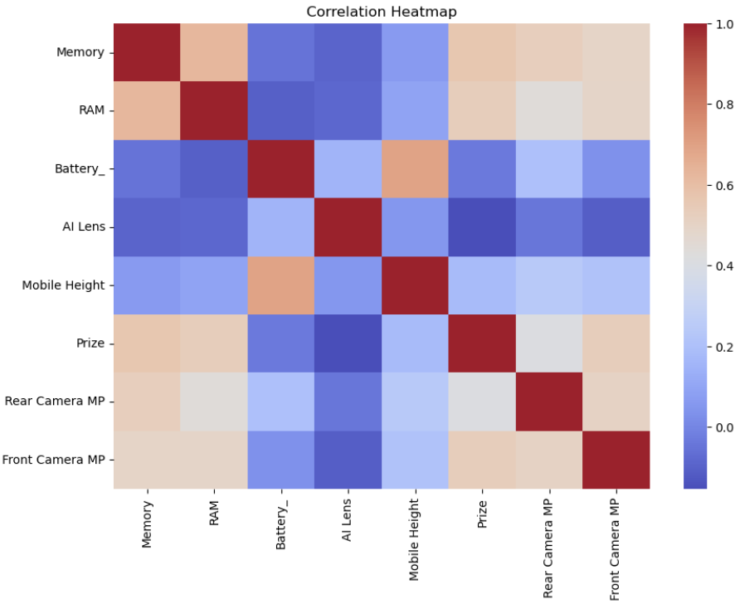
Visualizations & Insights
Correlation Heatmap
Shows statistical relationships between numerical features.
Key insight:
RAM and Storage have strong positive correlation with price.

Slide 12
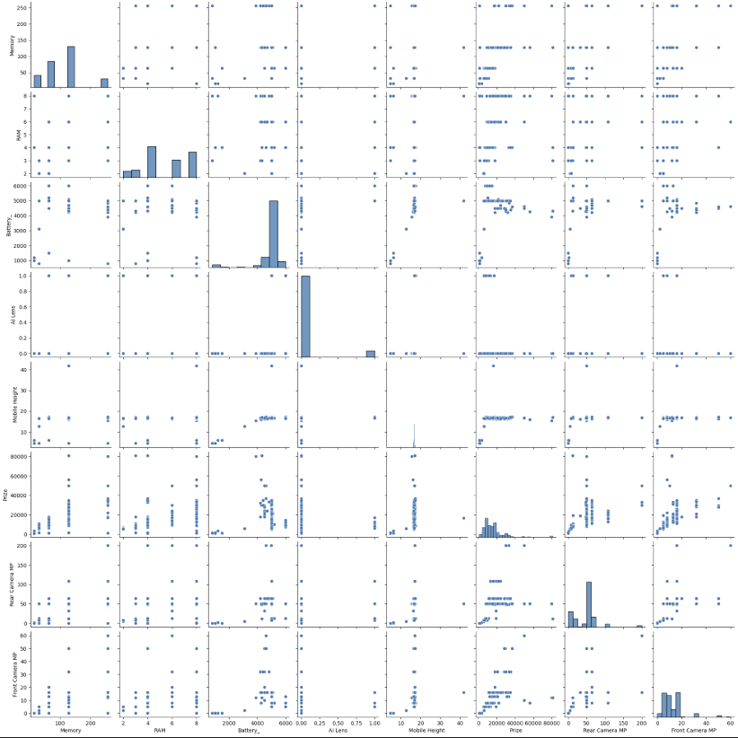
Visualizations & Insights Contd…
Pairplot Analysis
Helps visualize feature interactions.
Observed relationships:
Higher RAM → Higher price
Larger storage → Higher price
Better camera → Higher price

Slide 13
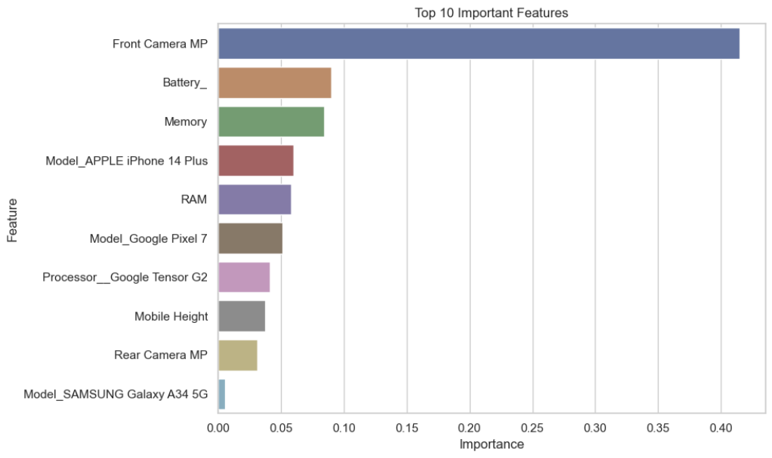
Visualizations & Insights Contd…
Feature Importance (Random Forest)
Top influential features identified:
Rank | Feature | Influence
1 | Front Camera MP | Very High
2 | Battery Capacity | High
3 | RAM | High
4 | Storage (Memory) | High
5 | Processor | Medium
6 | Rear Camera MP | Medium

Slide 14
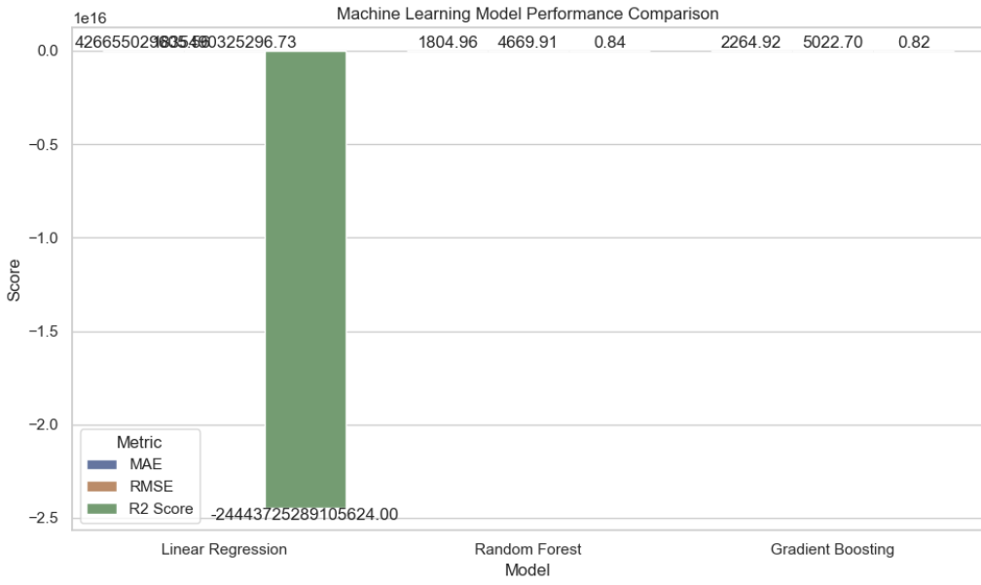
Visualizations & Insights Contd…
Model Comparison Visualization
compares model performance using RMSE values.
Observation:
Random Forest performed better than Linear Regression because it captures complex feature relationships.

Slide 15
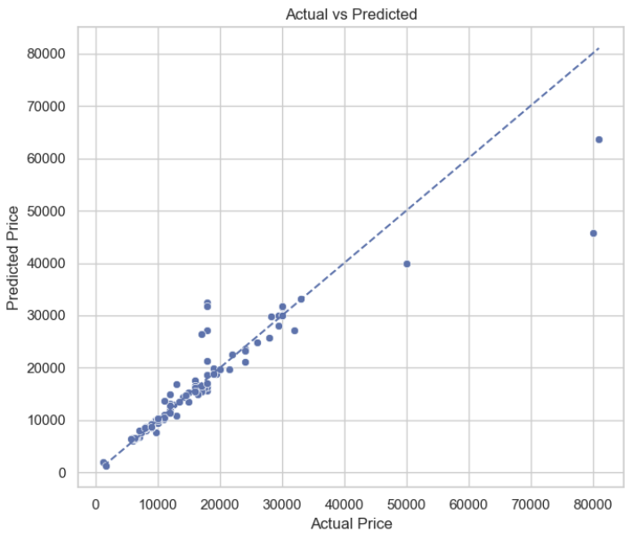
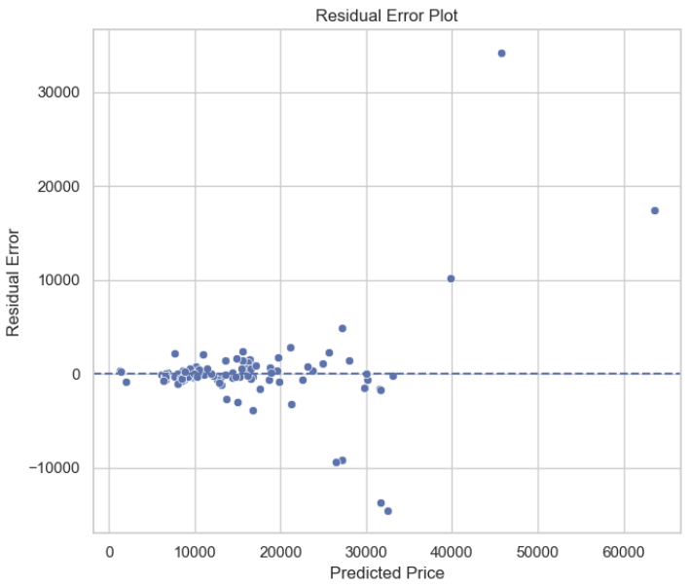
Visualizations & Insights Contd…

Slide 16
Key Insights from the Analysis
Smartphones with higher RAM and storage tend to have higher prices.
Camera specifications, especially front camera megapixels, significantly affect pricing.
Phones with larger batteries often belong to mid-range or premium segments.
Processor type influences pricing due to performance differences.

Slide 17
Recommendations for the Organization
Improve Camera Technology
Higher megapixel cameras significantly increase perceived value.
Recommendation: Focus on high-quality front cameras for premium devices.
Optimize RAM and Storage Combinations
Best-performing configurations include:
6GB RAM + 128GB Storage
8GB RAM + 256GB Storage
These combinations balance performance and price.
Use Premium Processors for High-End Models
Processor type strongly influences device cost.
Recommended chipsets:
Snapdragon
Dimensity
Tensor
Increase Battery Capacity
Large batteries (≥5000 mAh) improve device attractiveness in mid-range segments.

Slide 18
Conclusion
This project demonstrates how machine learning can effectively predict smartphone prices based on device specifications. Feature extraction techniques helped identify the most influential factors affecting price. Among the models evaluated, Random Forest provided the most accurate predictions. The insights derived from this analysis can help manufacturers and retailers design better pricing strategies and optimize smartphone configurations.

Slide 19
Thank You…

